Slide 1
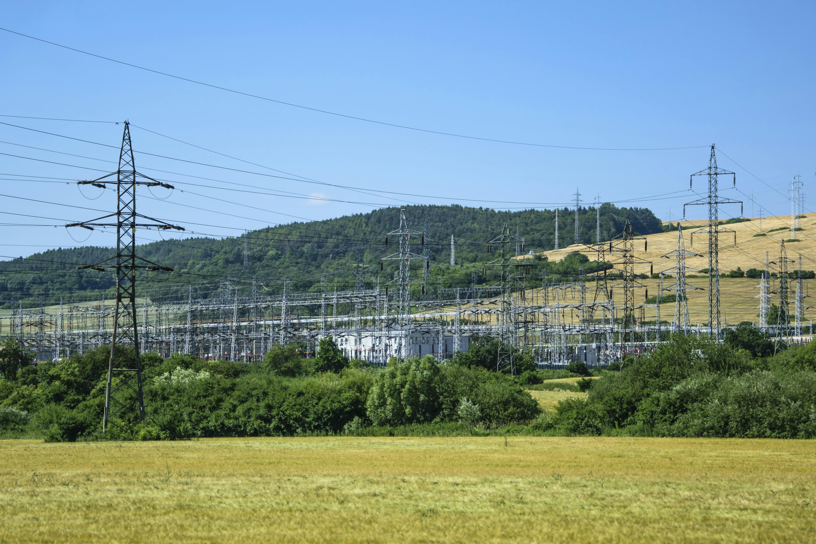


Performance Based Regulation (PBR)
PUR-2024-00152-Ex Parte: In the matter concerning performance-based regulation and alternative regulatory tools for investor-owned utilities
Virginia Department of Energy
Glenn Davis
Director
Virginia Department of Energy
Larry Corkey
Manager, Policy and Planning
Virginia Department of Energy
Jonika Rathi
Research Analyst
Virginia Department of Energy
October 28, 2024

Slide 2


About Performance Based Regulation (PBR)
Definition
An approach to utility regulation designed to strengthen utility incentives to improve performance and align utility priorities with those of customers and public policy. (NCSL)
Introduction

Slide 3

SCC
PBR study
SCC PBR STUDY

Slide 4
STAKEHOLDER Group Process
Activities Include:
Facilitated workshops and presentations on alternative regulatory tools,
Opportunities for open dialogue and meaningful input,
Access to the information and other resources necessary for robust engagement, and
The opportunity to respond to proposals, as appropriate.
Overview

Slide 5
GOALS
Outlined in HJ30/SJ47
Evaluate the potential of performance-based regulatory tools and alternative regulatory tools to modernize the legal or regulatory framework and
Consider the long-germ financial stability of investor-owned utilities and balance the interests of all stakeholders for the benefit of the Commonwealth.
Overview

Slide 6
Next steps:
Written comments due December 2, 2024
email jonika.rathi@energy.virginia.gov or use Townhall portal
Stakeholder meetings in December, 2024.
Next steps

